Slide 1
Design and cartographic elements

Slide 2
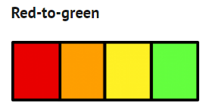
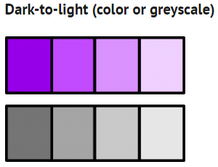
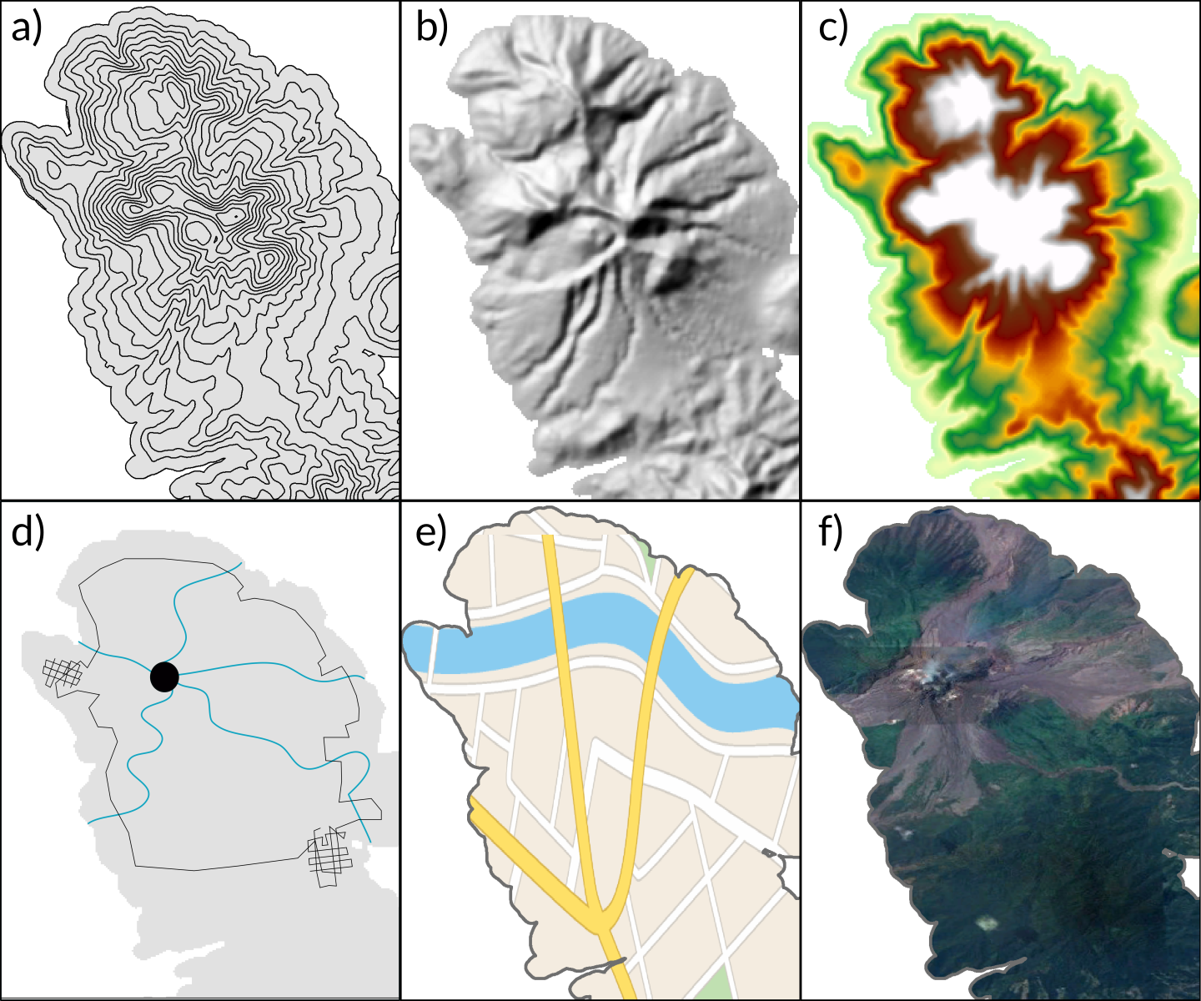
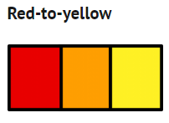
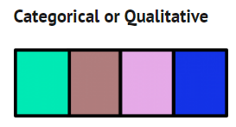
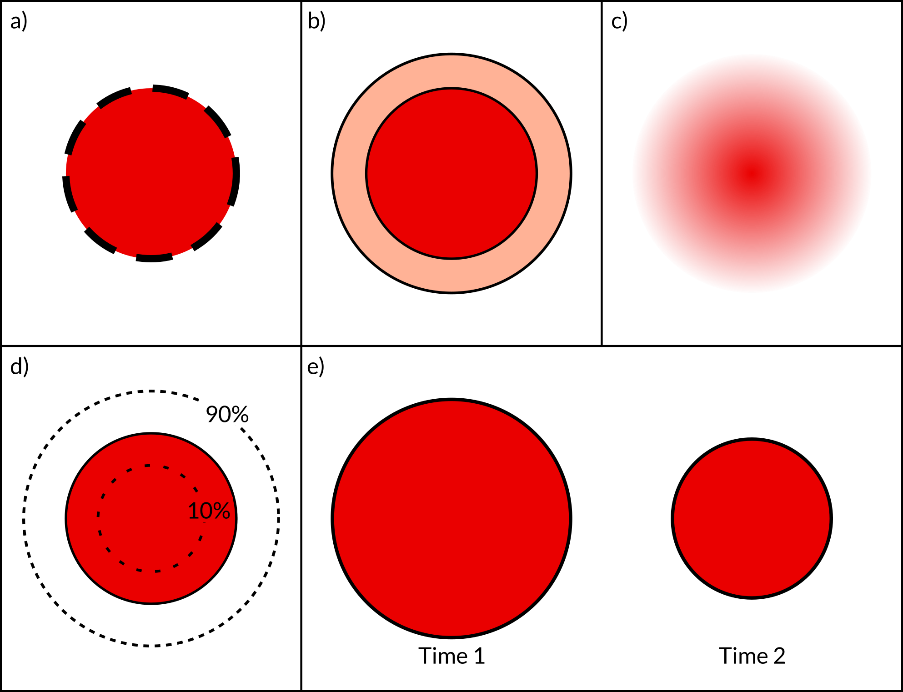
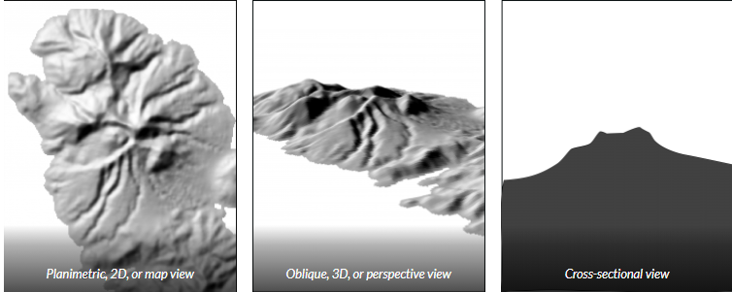
Design elements
Symbology
Buffer zones
Fuzzy boundaries/shading
Confidence limits
Different versions depicting evolving uncertainty

Slide 3


Color and contrast
The use of color helps to delineate shapes on maps, because human eyes are less sensitive to shapes than to color.
For this reason, the use of contrasting colors can help users identify the edges of shapes [Keller and Keller 1993].
The good use of color can positively influence the ability of a map to communicate hazard information, while poor use creates confusion.
http://colorbrewer2.org/
colorusage.arc.nasa.gov NASA AMES Color Usage Research Lab
https://eagereyes.org/basics/rainbow-color-map

Slide 4


Color basics
Hue: what most people mean by ‘color’
Saturation: ‘paleness’ or ‘vividness’, distance from grayscale
Brightness/Luminance: ‘tone’, low values are ‘dark’, high values are ‘light’
Luminance
Saturation

Slide 5
The logical ordering of sequential red-to-green “stoplight” color schemes (red means danger, yellow means caution, and green means safe) is fairly universal among cultures
This makes red-to-green color schemes easily understood for relative hazard levels
Red-to-green color scales may incorrectly imply that green zones are ‘safe’ rather than just the lowest hazard
Red-to-green color schemes can pose issues for individuals with red-green colorblindness
Dark-to-light sequential color schemes are also well-suited for conveying the relative degree of hazard for different hazard zones
Most effective when the darkest or most saturated hue represents high values
Appropriate for the color-blind
Sequential hazard levels (high-med-low) are more difficult to discern on maps using categorical or qualitative color schemes, as the map reader must closely study the map legend
However, well-selected categorical colors may be appropriate for maps displaying non-ordered or categorical data, as is the case for hazard process-focused maps
Most commonly used
Users are able to quickly order hazard zones from highest to lowest hazard
No zones are misinterpreted to be ‘safe zones’ (as is the case when using the color green)
More easily understood by people with color-blindness

Slide 6
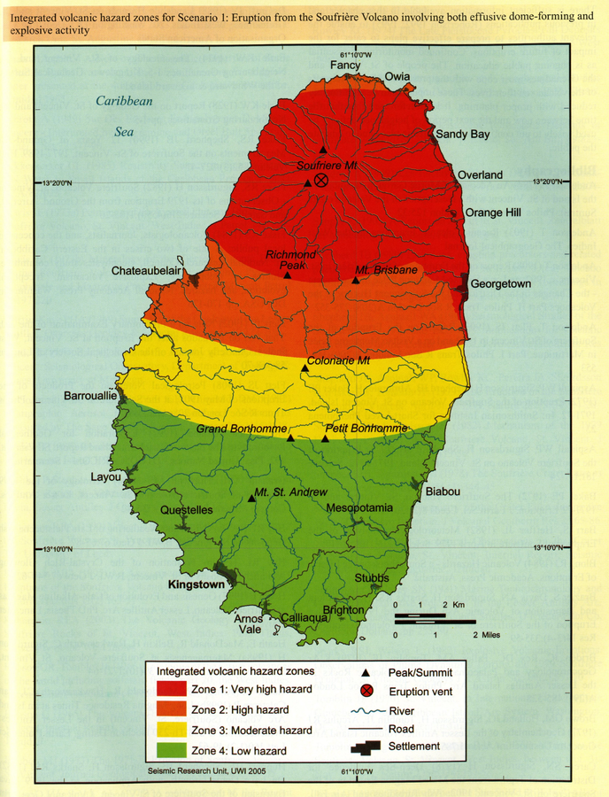
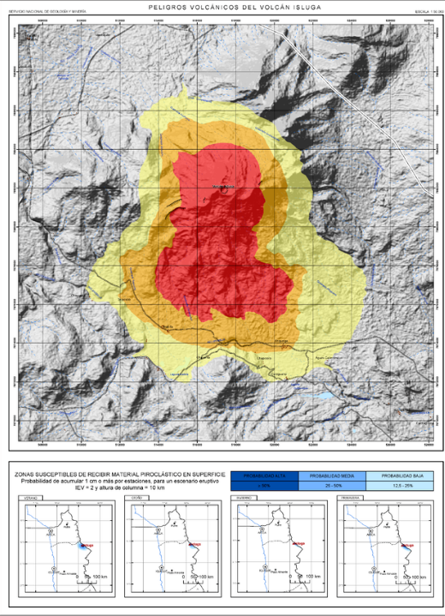
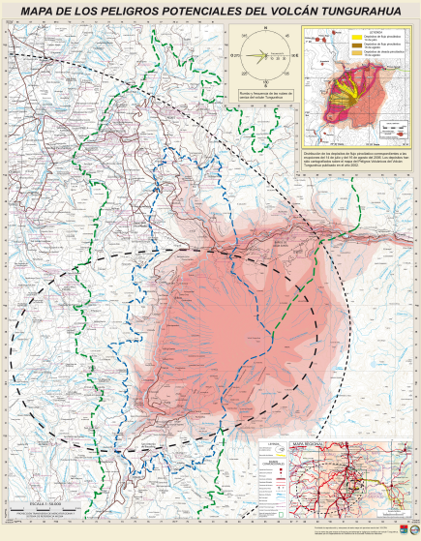
Hazard level-focused (integrated)
Soufrière St. Vincent (Robertson, 2005)
Isluga, Chile (Bertin & Amigo, 2013)
Tungurahua, Ecuador (Samaniengo et al., 2008)

Slide 7
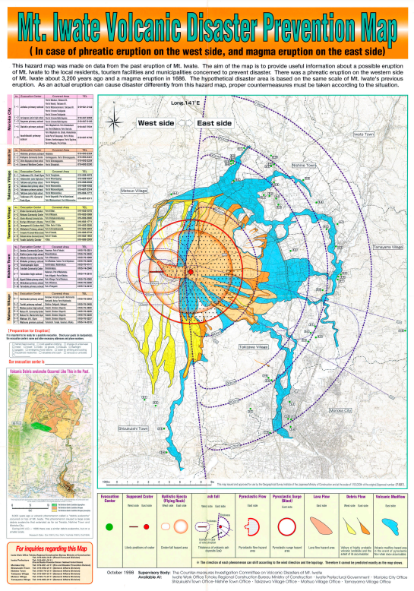
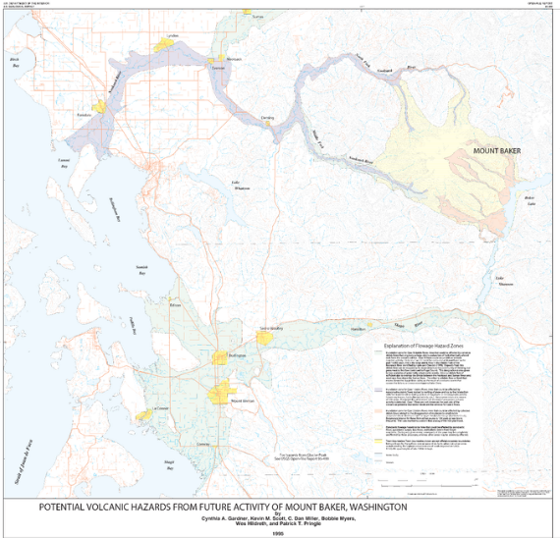
Hazard process-focused (separated)
Iwatesan, Japan (1998)
Baker, United States (Gardner et al., 1995)

Slide 8
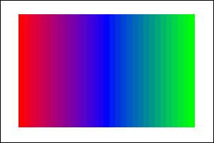
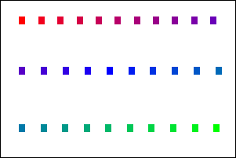
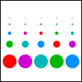
Color-coding
Small color differences can be distinguished when the areas to be discriminated are large, immediately adjacent to each other and are displayed at the same time.
These conditions occur, for example, in visualization of quantized continuous data as in maps of weather, temperatures, pressures or terrain.
Larger color differences are required whenever conditions deviate from this optimum.

Slide 9
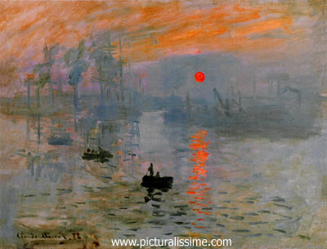
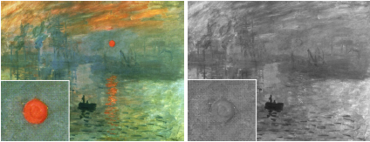
Isoluminance
Claude Monet

Slide 10
Isoluminance

Slide 11
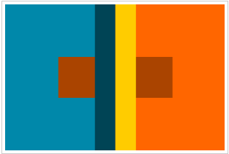
Simultaneous contrast

Slide 12
Simultaneous contrast

Slide 13
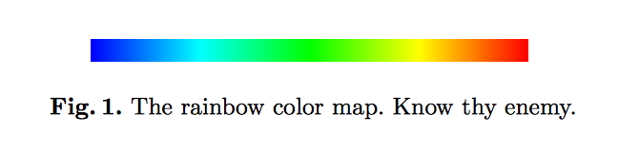
Image from K. Moreland
tiny.cc/endrainbow
#endrainbow
http://presentations.copernicus.org/EGU2016-3028_presentation.pdf
Slide courtesy Ed Hawkins, EGU 2016 Making Better Scientific Graphics

Slide 14
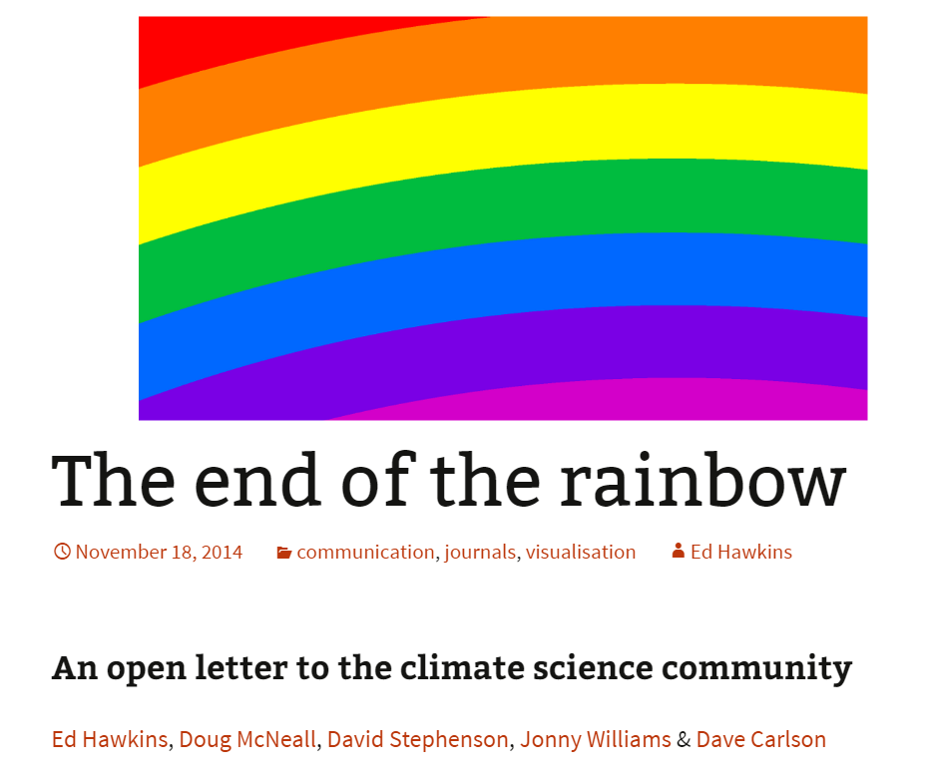

Slide 15
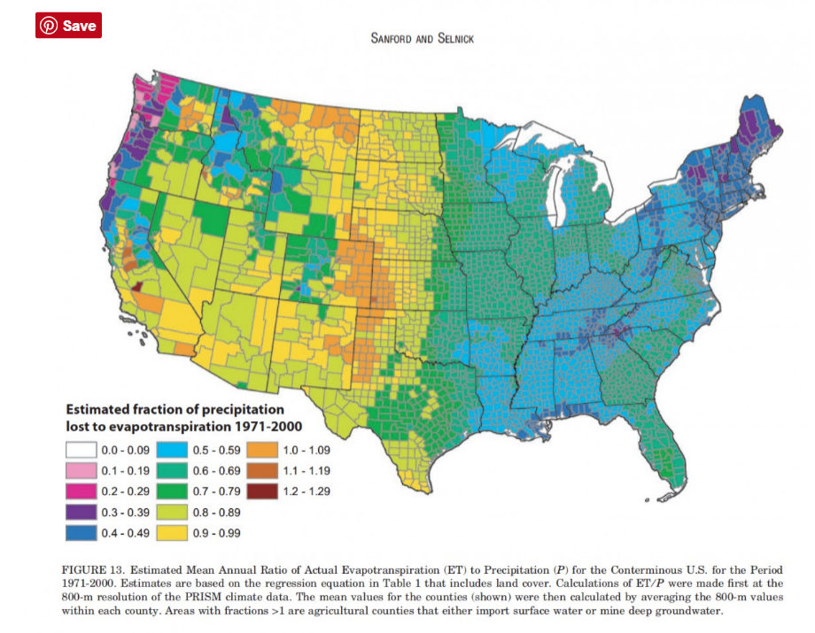
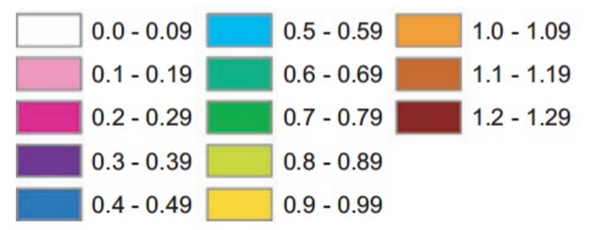
https://eagereyes.org/basics/rainbow-color-map

Slide 16
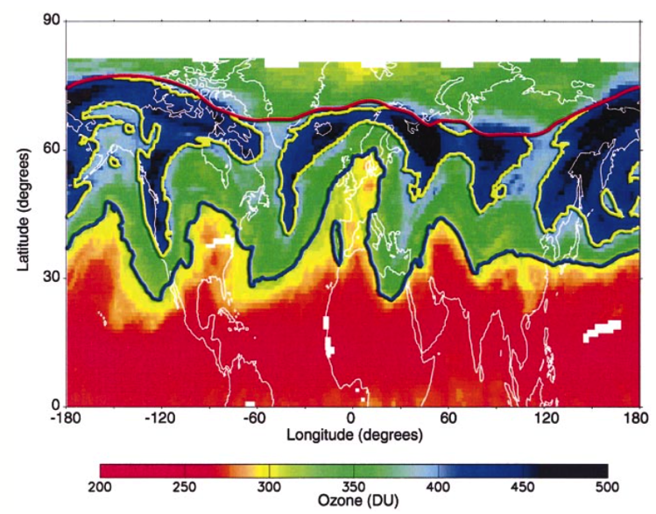
Dangers of rainbow colour scales
Subtropical front
Slide courtesy Ed Hawkins, EGU 2016 Making Better Scientific Graphics

Slide 17
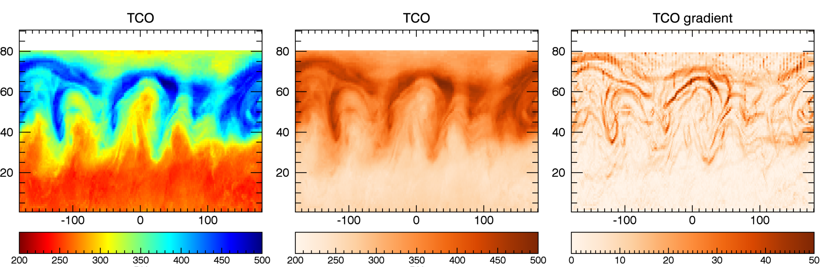
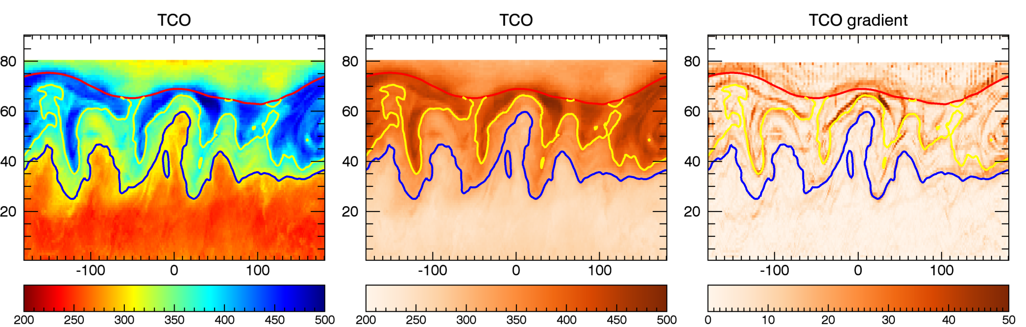
‘Sub-tropical’ front is an artefact of the colour scale
Figures from Sean Davis
Slide courtesy Ed Hawkins, EGU 2016 Making Better Scientific Graphics

Slide 18
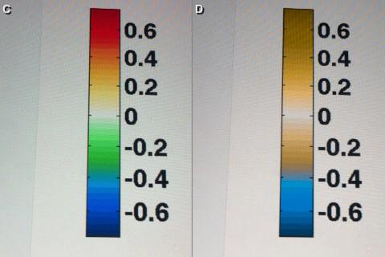
“Chromatic Vision Simulator” Kazunori Asada mobile phone app
Slide courtesy Ed Hawkins, EGU 2016 Making Better Scientific Graphics

Slide 19
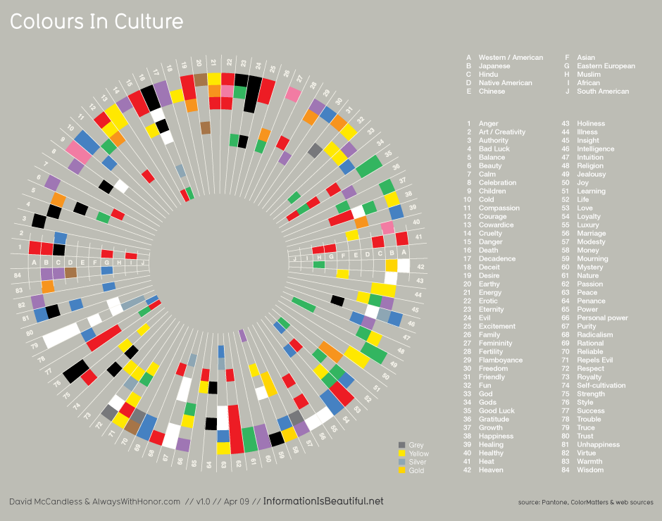
The risk hierarchy for color (red means danger, orange means warning, yellow means caution, and green mean safe) has found to be widespread among cultures [Wolgalter et al, 1997; Hupka et al, 1997; Dunlap at al, 1986]. Because of this though, red shouldn’t be used for other things!

Slide 20
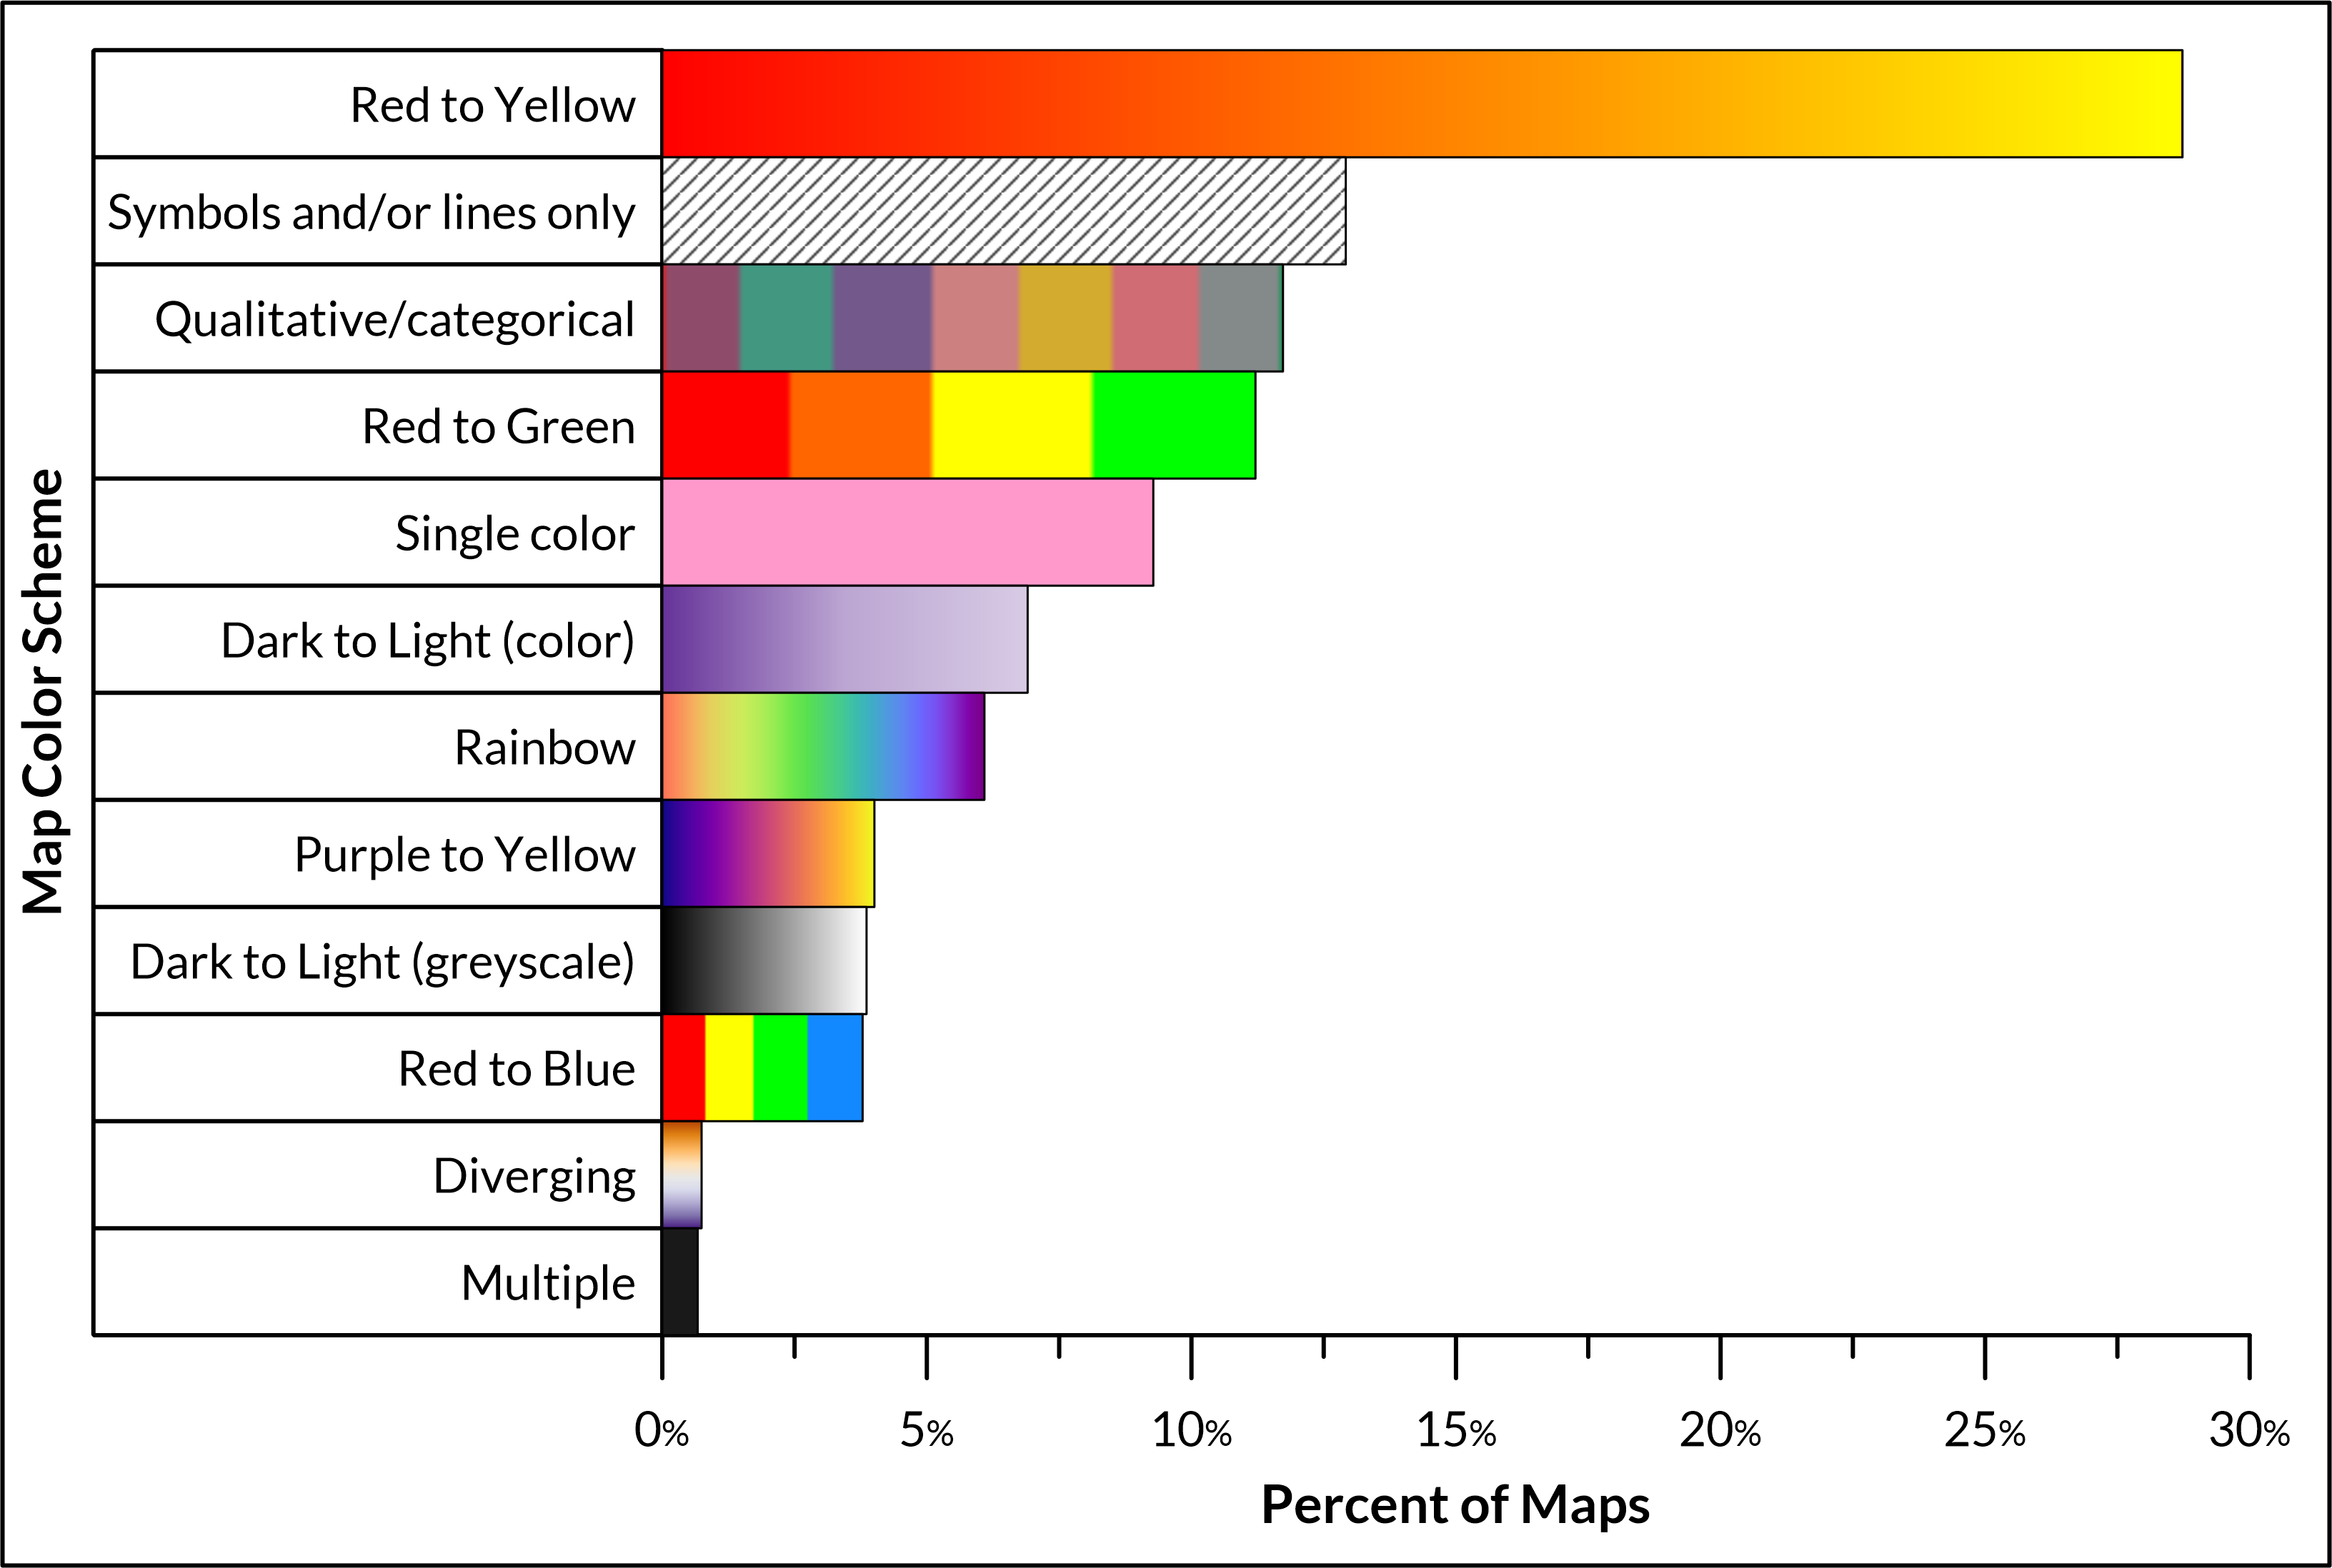
Design elements: color scheme

Slide 21
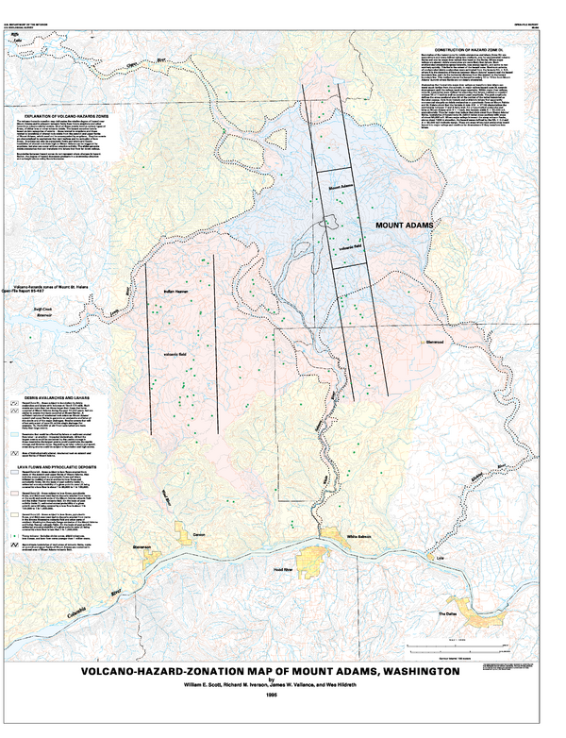
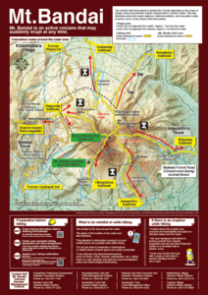
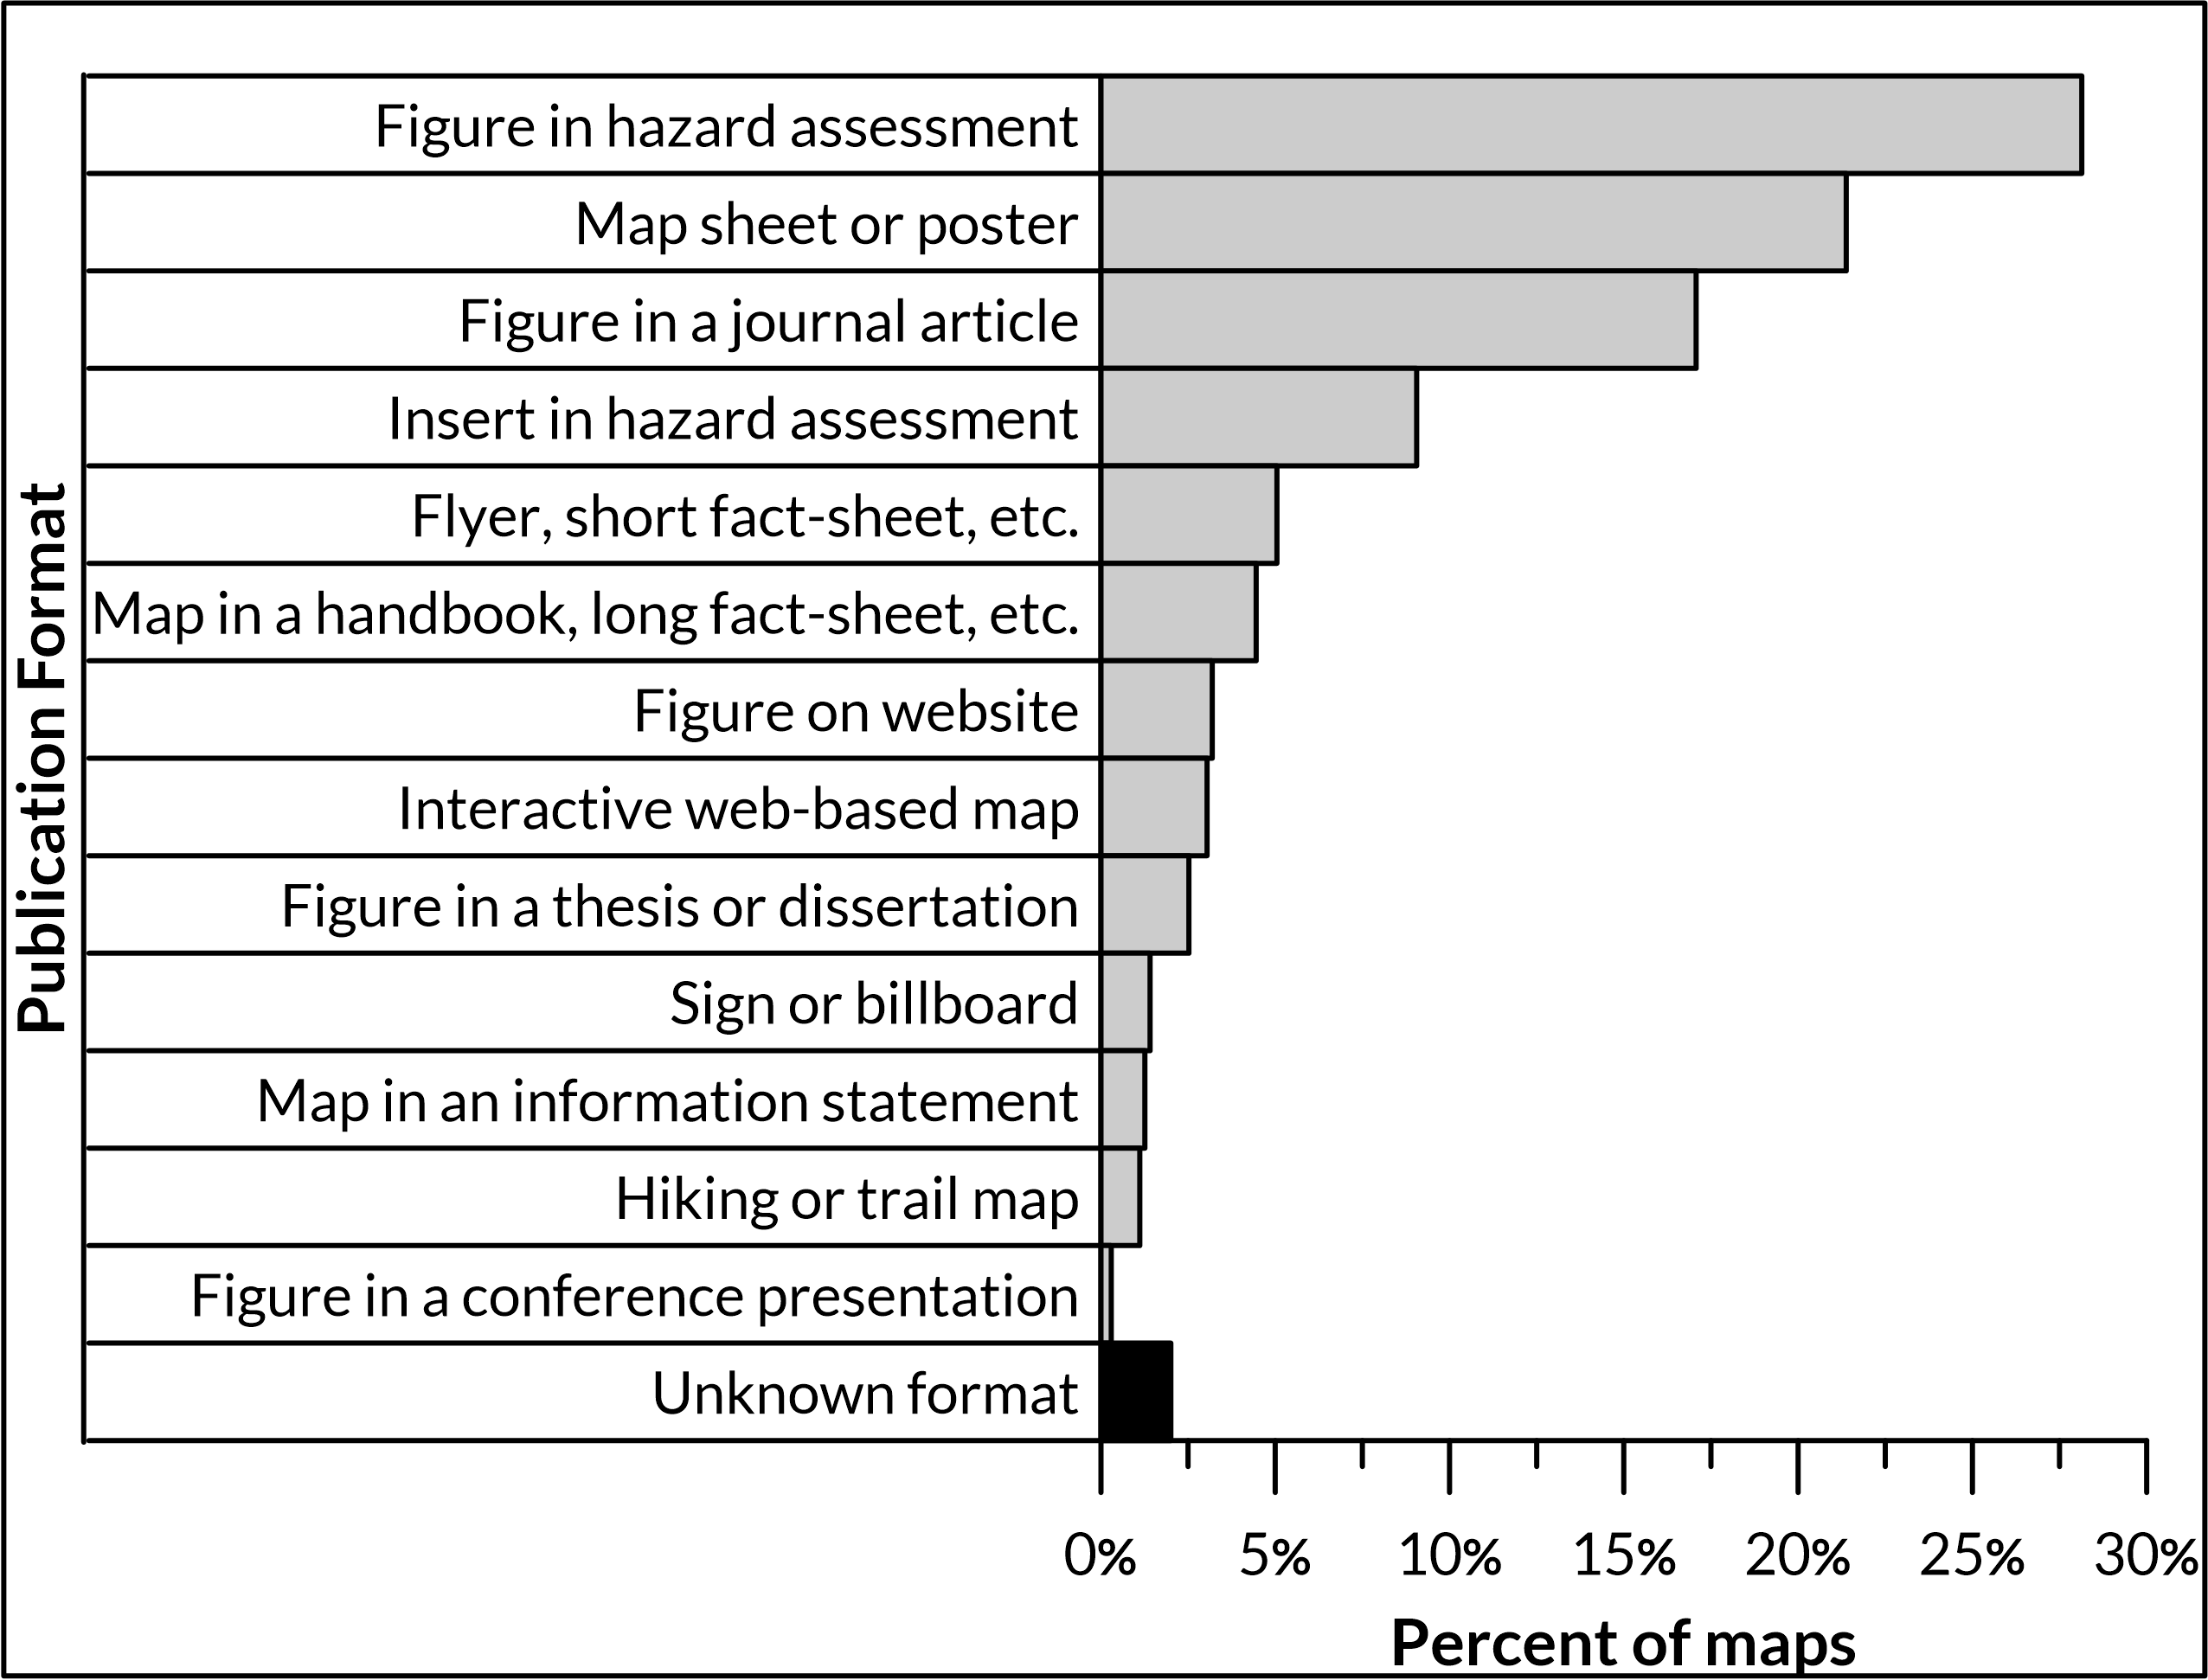
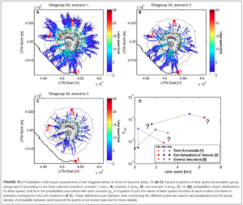
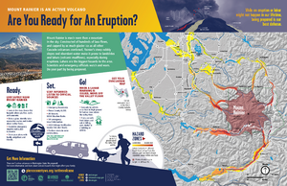
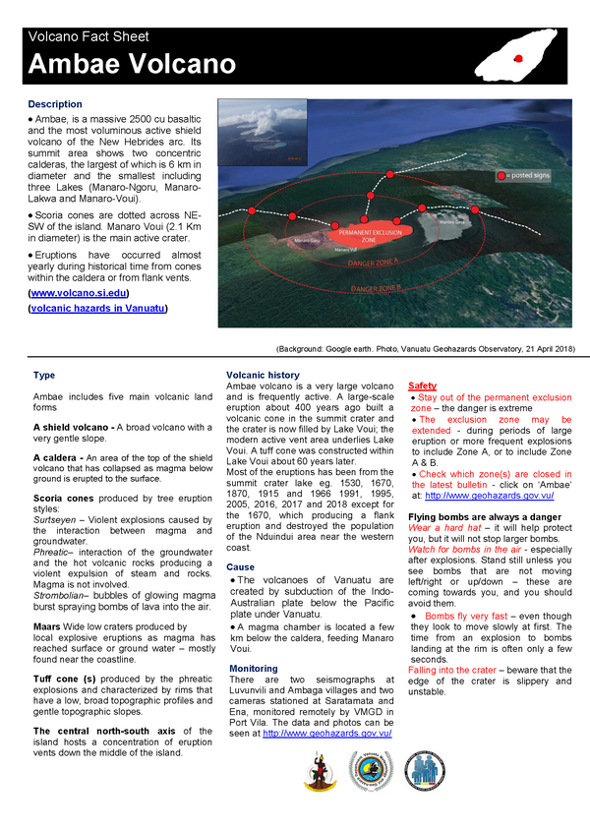
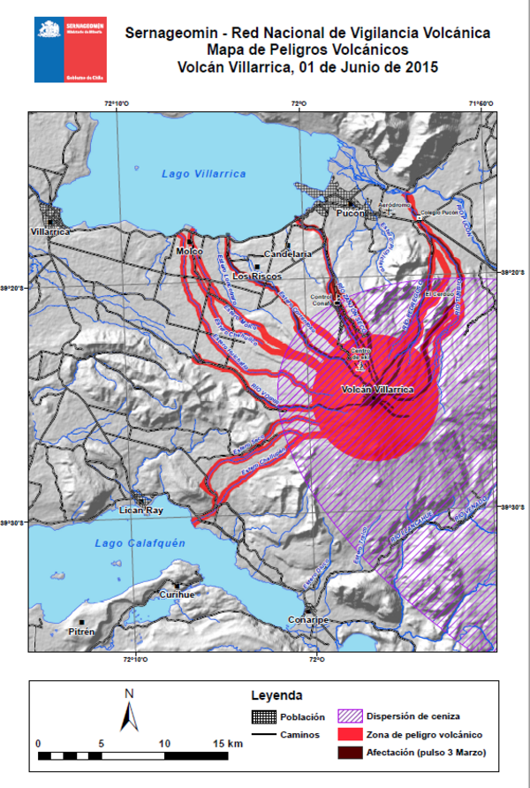
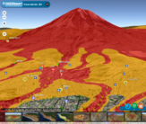
Design elements: Map publication format
Adams, USA
USGS
Bandai, Japan
Bandaisan Volcanic Disaster Management Council
Vesuvius, Italy
Tierz et al. (2017)
Rainier, USA
USGS
Ambae, Vanuatu
Govt. Vanuatu
Villarrica, Chile
SERNAGEOMIN
El Misti, Peru
INGEMMET

Slide 22
Design elements: basemaps and overlays
Hillshade DEMs are the most common basemap used by volcanic hazard maps in the database (44%).
Studies have shown that hillshade maps are much more intuitive for topography interpretation than contour maps (Haugerud & Greenberg 1998; Konnelly 2002). Contour maps require specialized training to interpret and are not intuitive for the general public
Research has shown that satellite images or photographs are particularly easy for the general public to interpret (Haynes et al. 2007). However, it may be difficult to layer hazard zone and other information on photographs without the map becoming cluttered or obscuring the photographic base.

Slide 23
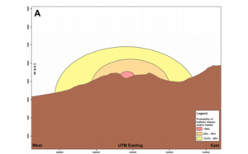
Design elements: map view/dimensionality
El Misti, Peru
INGEMMET
Lascar, Chile
Bertin (2017)
Adams, USA, USGS

Slide 24
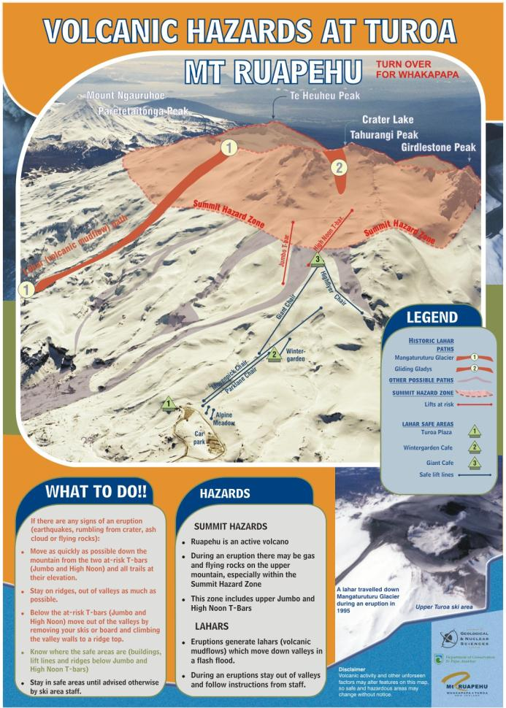
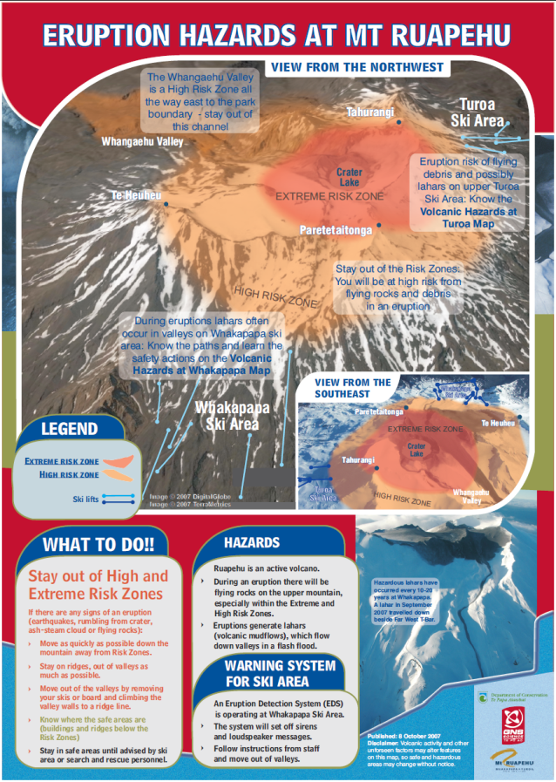

Slide 25
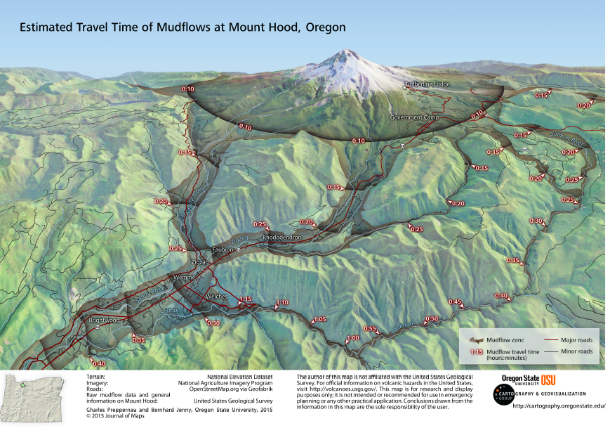

Slide 26
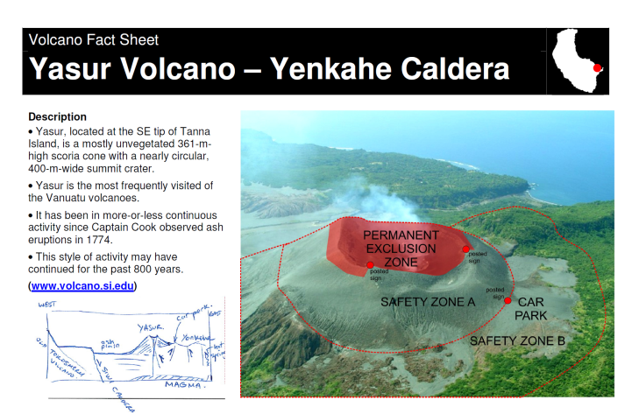

Slide 27
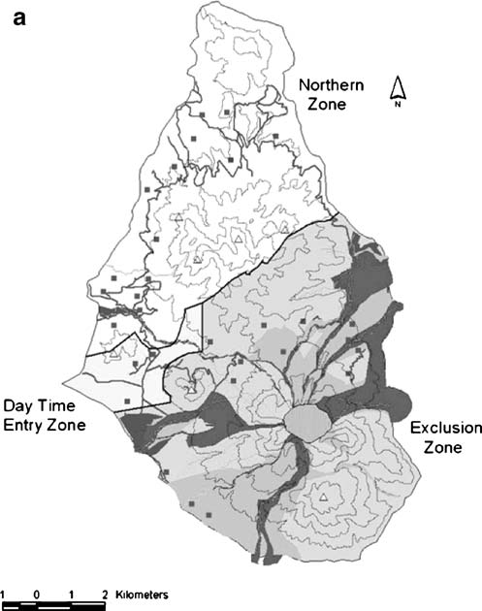
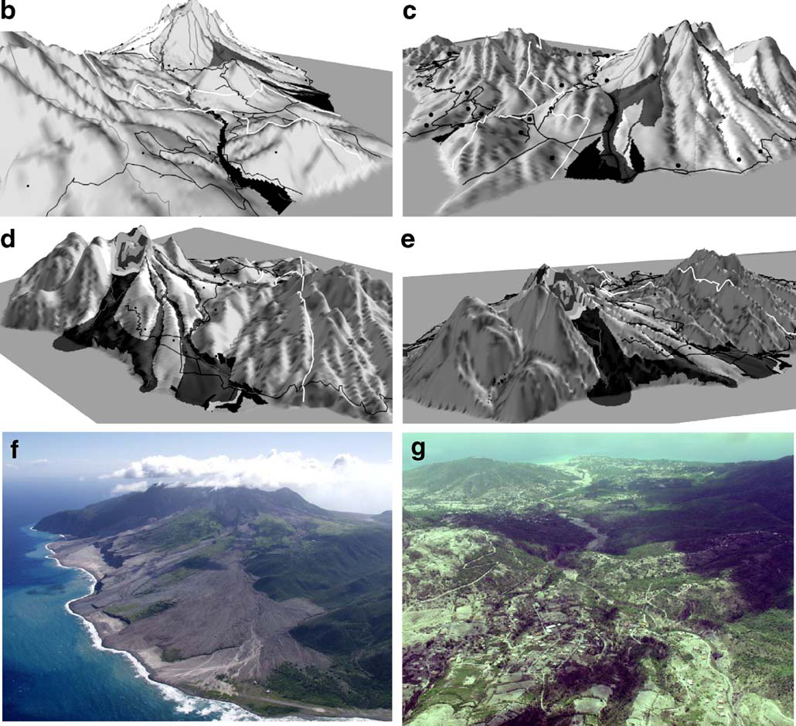
Dimensionality and base-maps
Each of these has been shown to have particular advantages and disadvantages that may vary cross-culturally [Bostrom et al, 2008].
In general, 3D visualizations are better at conveying shape, while 2D visualizations facilitate the understanding of the relative position of two objects [Bostrom et al, 2008].
Haynes, K., Barclay, J., and Pidgeon, N. 2007. Volcanic hazard communication using maps: an evaluation of their effectiveness. Bulletin of Volcanology, 70: 123-138.

Slide 28

Dimensionality and base-maps
Orienting: Finding north was easier on the 2-D contour map, perhaps because maps are normally oriented with north at the top, otherwise similar
Locating: easier using photographs than 3D maps or 2D contour.
Map skills: Good when using photographs and 3D maps. Contour lines were found to be extremely confusing. Often, linear features such as roads, the boundaries of the exclusion zone, and the contours themselves were confused with one another.
Volcanic information: improved using 3D and photographic maps over 2D contour maps. Some respondents reevaluated their perceptions of danger when they were presented with the aerial photograph maps. One woman was shocked to discover that the Belham Valley was a direct pathway for pyroclastic flows to travel from the volcano, whereas before she couldn’t understand why the area had been evacuated.

Slide 29
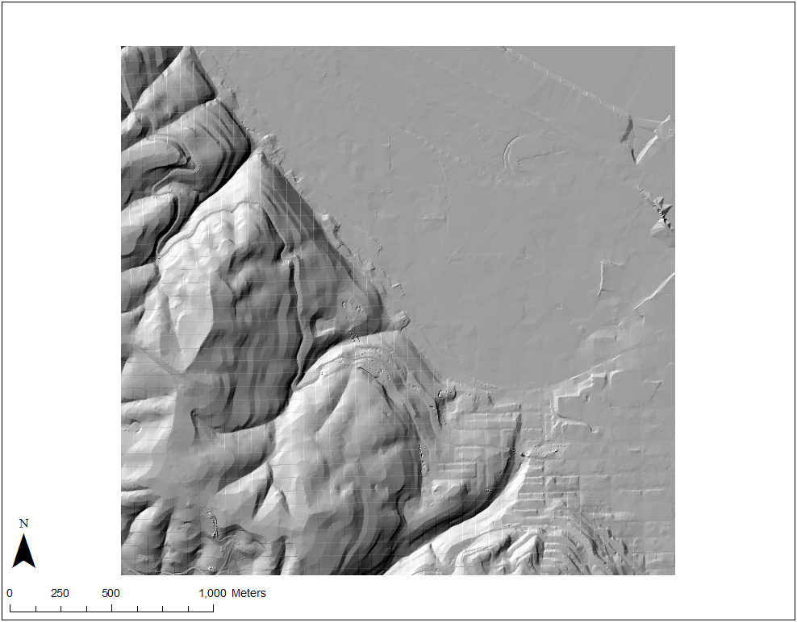
Hillshade

Slide 30
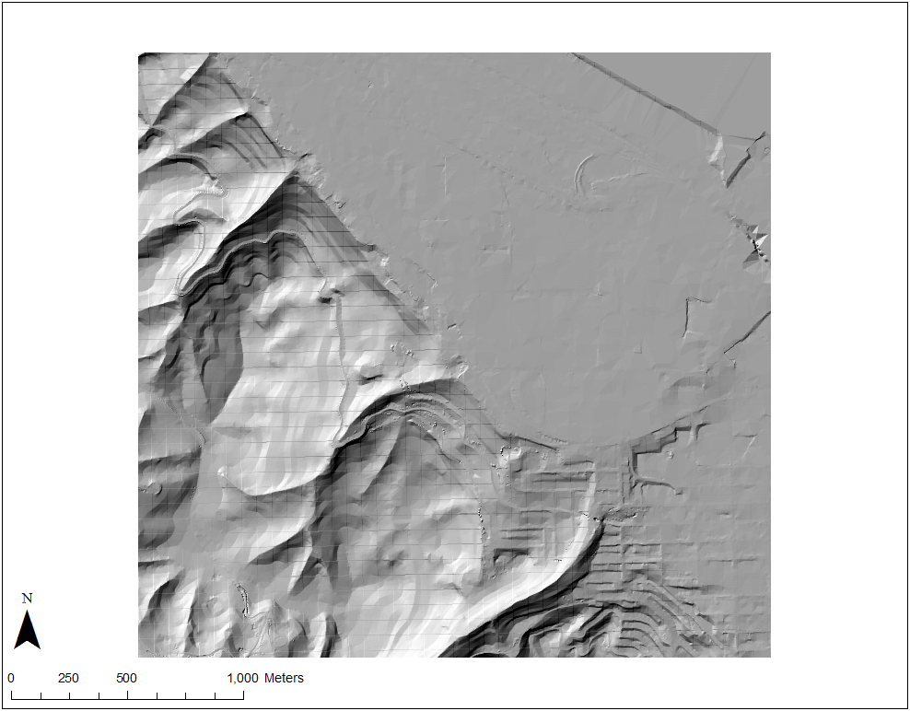
Hillshade

Slide 31
Hillshade
Illuminate from top left (from NW, 315°)
Illuminate from bottom right (from SE)
This is known as the pseudoscopic illusion, and cartographers have known that it impacts the interpretation of shaded relief maps for a very long time. While most people will interpret terrain correctly when shaded from a northwest illuminator, there is a smaller (but not insignificant) group of people that will actually perceive these maps in completely the opposite way.

Slide 32
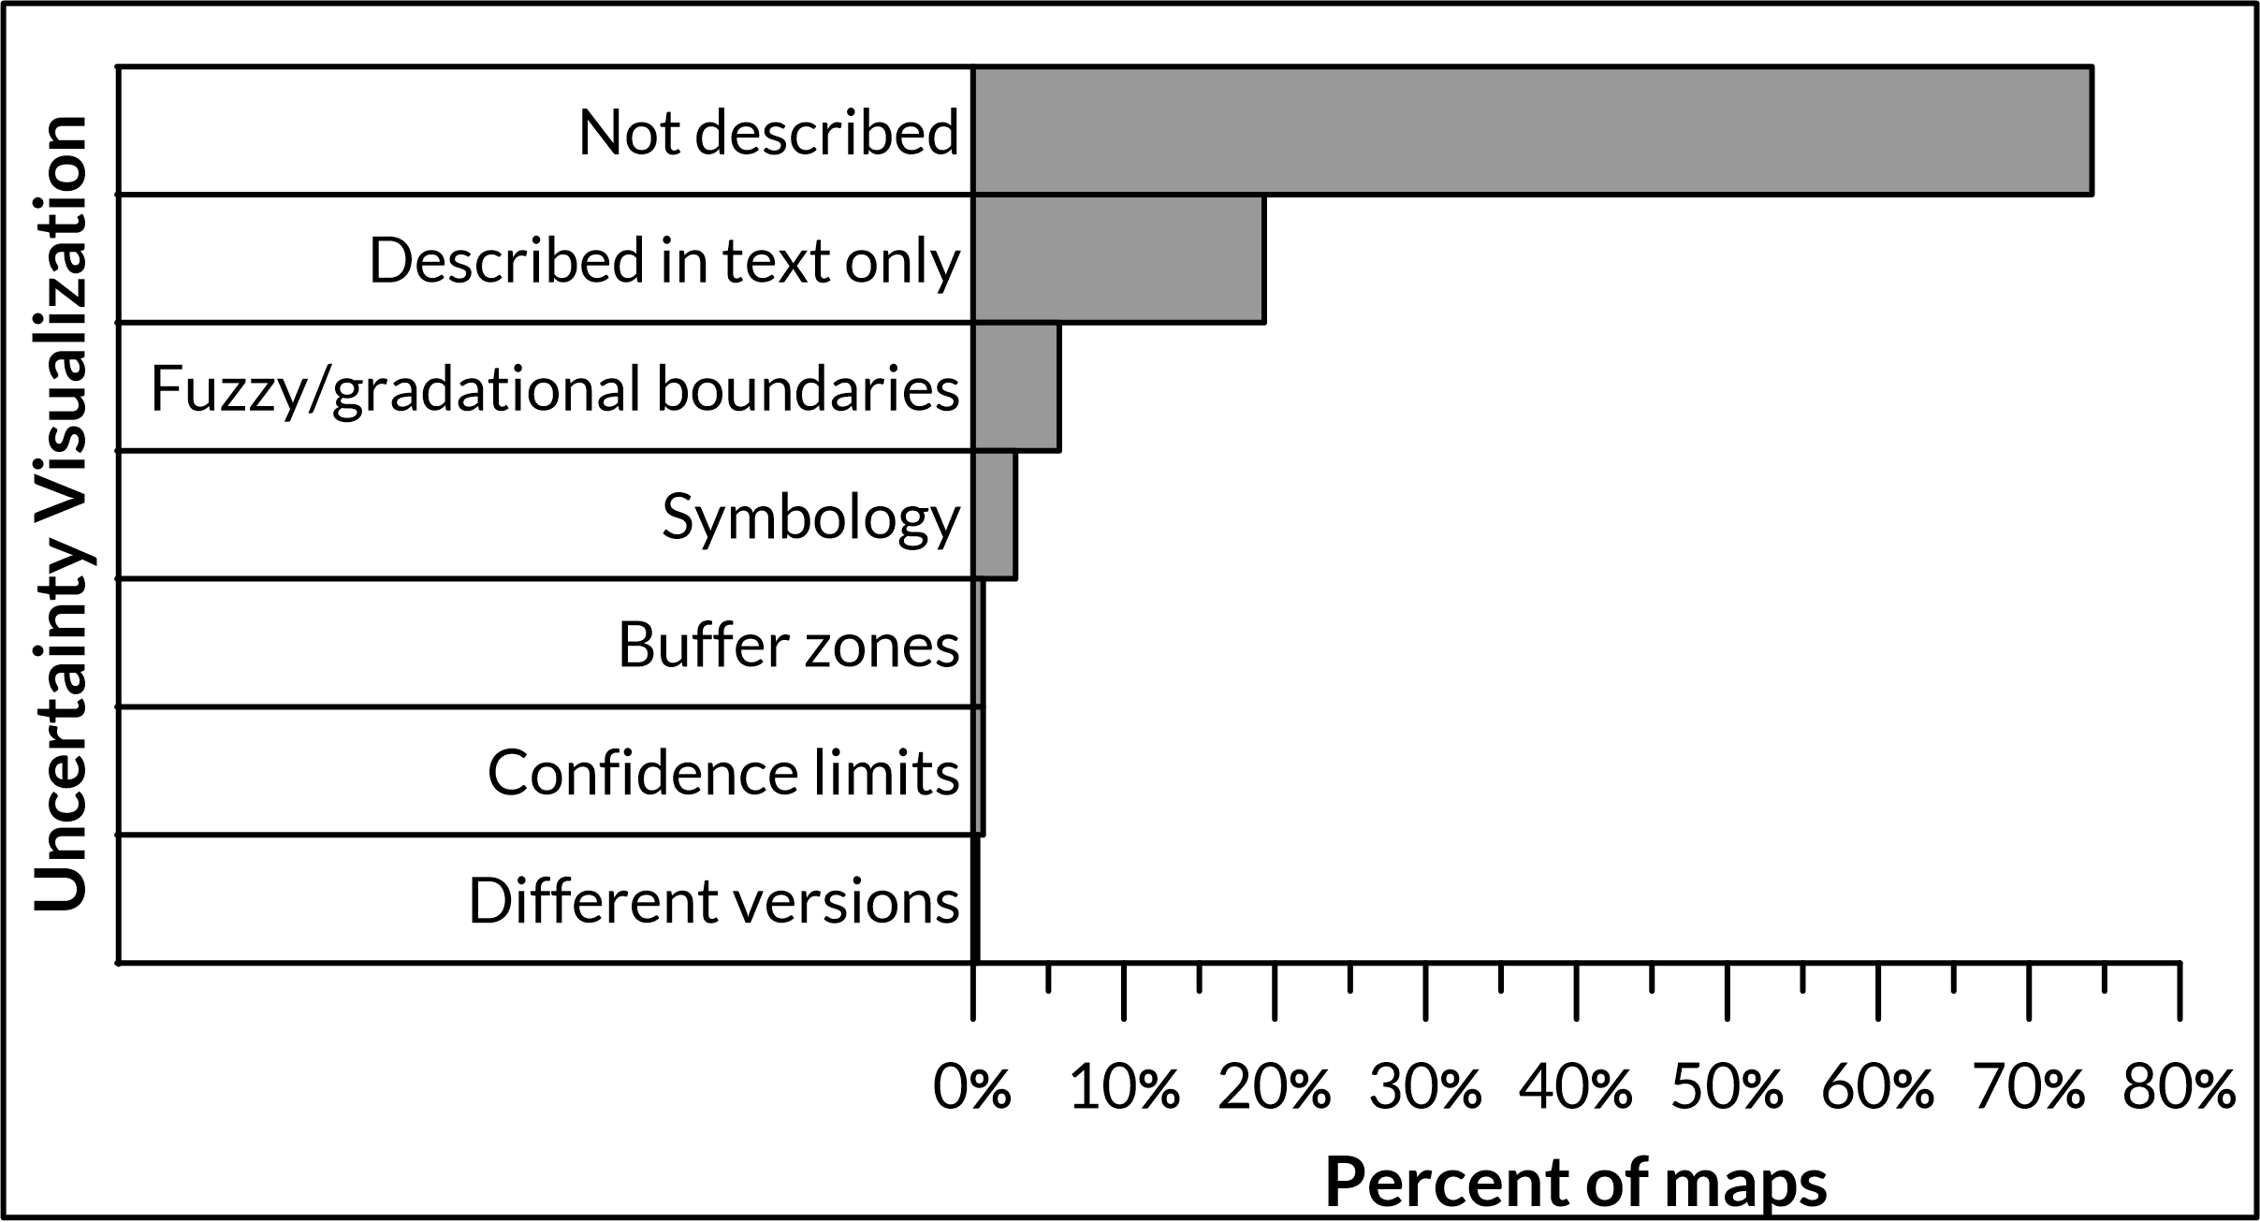
Hazard Zone Uncertainty
Symbology
Buffer zones
Fuzzy boundaries
Confidence limits
Different versions depicting evolving uncertainty

Slide 33
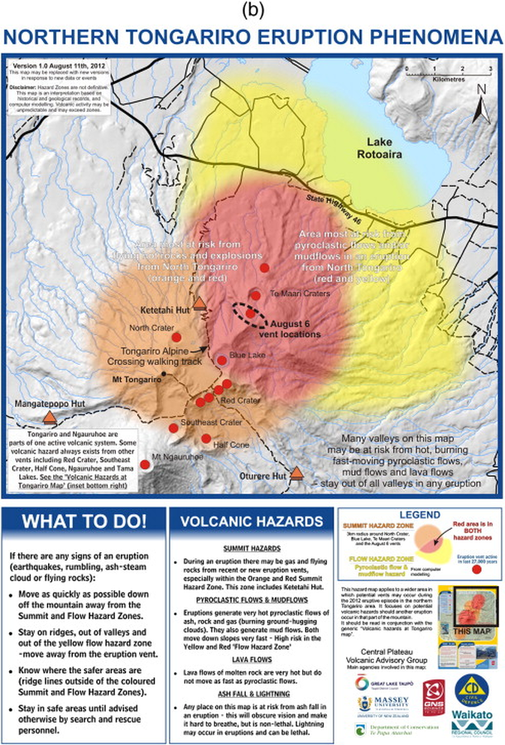
Fuzzy boundaries
Tongariro, New Zealand (GNS, 2012)

Slide 34
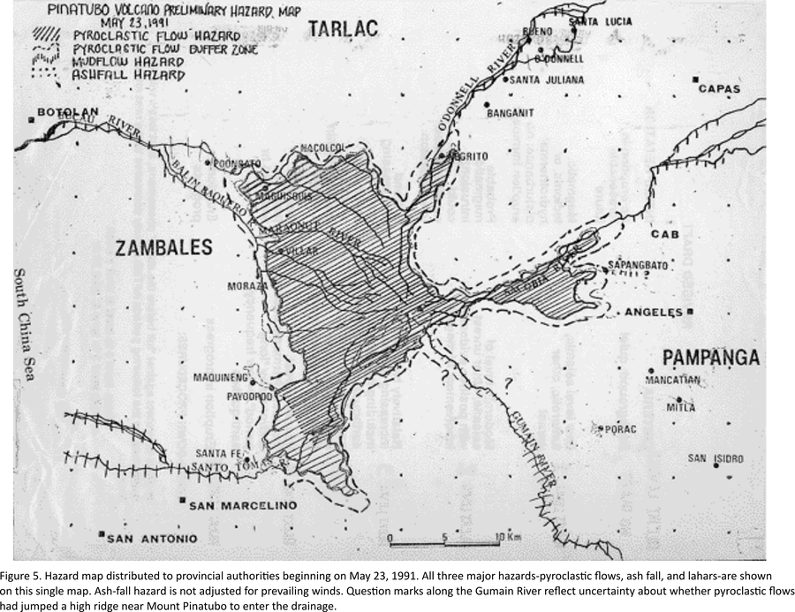
Buffer zones

Slide 35
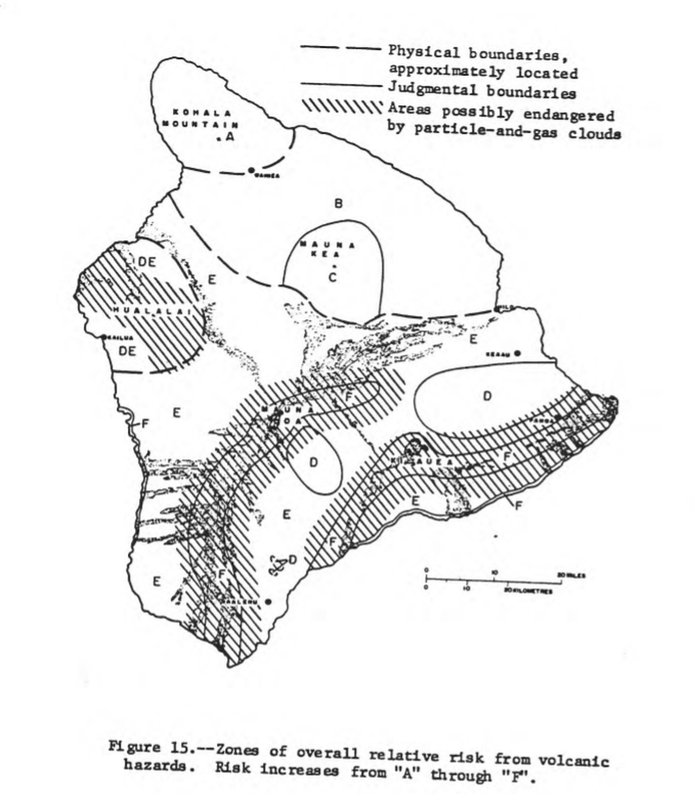
Symbology

Slide 36
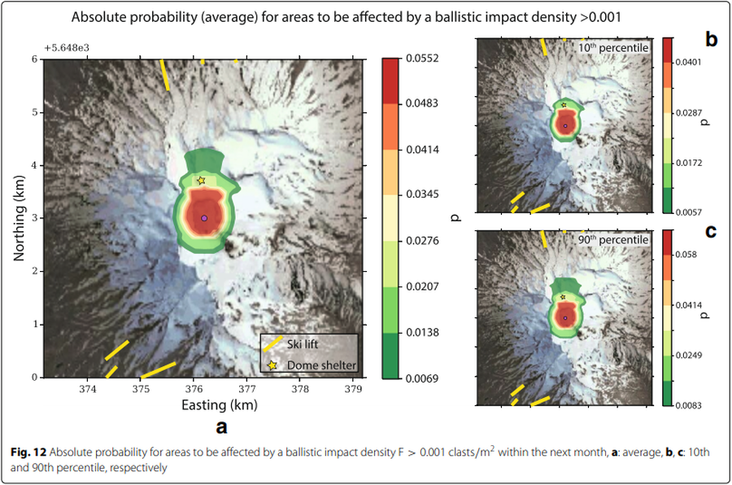
Confidence intervals
Ruapehu, New Zealand (Strehlow et al. 2017)

Slide 37

Confidence intervals
Changbaishan [Baekdusan], China-North Korea (Yun & Chang, 2017)

Slide 38
Map element | Description | % of maps
actions to take | The map describes what to do during unrest or eruption | 22
alert level scheme | The alert level scheme for the volcano is described | 11
area map | An area map is included that shows the regional context | 24
audience and/or purpose | The intended audience or purpose is described | 11
cartographic legend | A legend is provided for cartographic symbols (e.g. roads, lakes) | 52
color scheme order | Color scheme is in order (e.g. red = high hazard) | 58
conditional validity | The conditions under which the map is valid are described (e.g. VEI < 5, central vent eruptions) | 26
coordinates | Geographic coordinates are shown | 58
eruptive history | The eruptive history of the volcano is described | 21
evacuation route | Evacuation routes are visually depicted on the map | 10
expiration | The conditions that will trigger map revision are described (e.g. summit changes, a time limit, new information) | 6
glossary of terms | Geological terms are defined in a glossary section | 6
hazard details | Hazard processes are defined or described | 18
hazard travel time | Hazard arrival times or velocities are depicted or described | 13
hazard zone description | Hazard zones have accompanying descriptions beyond labels | 74
hazard zone legend | A legend is provided for the hazard zones | 90
impact details | Impact details (e.g. roof collapse, crop damage) are described | 20
impact locations | Specific towns or drainages are named or listed | 15
insets | Insets containing non-map information are included | 26
methods | Hazard zonation methods are described in the text | 22
more information source | Sources for additional information are given | 17
north arrow | A north arrow is included | 67
oblique image included | Oblique (3D) inset images of the terrain or hazard zones are shown | 4
other volcanos | Hazard zones from nearby volcanos are also shown on the map | 3
past deposits | Deposits from previous eruptions are shown visually | 16
person hours | The amount of time required to make the map is stated | 1
photos | Photos of the volcano, deposits, impacts, etc. are shown | 12
population information | Population information (e.g. numbers of inhabitants in towns or hazard zones) is depicted or described | 9
references | Reference literature is cited | 16
safe areas | Safe areas, including shelters or muster points, are depicted | 13
scale bar | A scale bar is included | 86
version number | Version numbers or a revision history is provided | 10
wind rose diagram | A wind rose diagram of either wind directions or tephra dispersal directions is provided | 1

Slide 39


Slide 40


Ruapehu, New Zealand (GNS Science 2021)
Bandai, Japan (Bandaisan Volcanic Disaster Management Council, 2019)

Slide 41

Sakurajima (Aira), Japan
(Kagoshima City 2018)

Slide 42



Slide 43




Slide 44

Web resources
betterfigures.org
climate-lab-book.ac.uk
http://colorbrewer2.org/
colorusage.arc.nasa.gov NASA AMES Color Usage Research Lab
https://eagereyes.org/basics/rainbow-color-map

Slide 45
Albers, J. 1963. Interaction of Color. Yale University Press, New Haven.
Bartels, C.J. and van Beurden, A.U.C.J. 1998. Using geographics and cartographic principles for environmental assessment and risk mapping. Journal of Hazardous Materials, 61:115-124.
Bostrom, A., Anselin, L., Farris, J. 2008. Visualizing seismic risk and uncertainty. Annals of the New York Academy of Sciences, 1128: 29-40
Cashman, K.V., and Cronin, S.J. 2008. Welcoming a monster to the world: myths, oral tradition, and modern societal response to volcanic disasters. Journal of Volcanology and Geothermal Research, 176:407-418
Collins, R.F. 1998. Risk visualization as a means for altering hazard cognition. Unpublished dissertation, University of South Carolina, South Carolina.
Cronin, S.J., et al. 2004. Participatory methods of incorporating scientific with traditional knowledge for volcanic hazard management on Ambae Isalnd, Vanuatu. Bulletin of Volcanology, 66: 652-668.
Dunlap, G. L., Granda, R.E., Kustas, M. S. 1986. Observer Perceptions of Implied
Hazard: Safety Signal Words and Color Words (Technical Report TR 00.3428,
IBM, Poughkeepsie, NY).
Fordham, M. 2001. Challenging boundaries: A gender perspective on early warning in disaster and environmental management. United Nations Division for the Advancement of Women, International Strategy for Disaster Reduction, Expert Group Meeting, EGM/NATDIS/2001/EP.5
Handmer, J. 1985. Floodplain maps: uses and limitations as public information. In: Abstracts of the 13th New Zealand Geographical Society Conference, Hamilton, New Zealand
Haynes, K., Barclay, J., and Pidgeon, N. 2007. Volcanic hazard communication using maps: an evaluation of their effectiveness. Bulletin of Volcanology, 70: 123-138.
Haynes, K., Barclay, J., Pidgeon, N. 2008. The issue of trust and its influence on risk communication during a volcanic crisis. Bulletin of Volcanology, 70: 605-621.
Heywood I, Cornelius S, Carver S. 1998. Introduction to Geographical Information Systems. Harlow: Addison Wesley Longman.
Hupka, R. B., et al. 1997. The colors of anger, envy, fear, and jealousy. Journal of Cross-Cultural Psychology, 28: 156-171.
Keller, P.R. and Keller, M.M. 1993. Visual cues: practical data visualization. IEEE Press, New Jersey.
Kunz, M., and Hurni, L. 2008. Hazard maps in Switzerland: State-of-the-art and potential improvements. Mountain Mapping and Visualization 6th ICA Mountain Cartography Workshop, Lenk, Switzerland.
Lantzy, R.J., Cichy, P.T., Leitzinger, A.H. 1998. Use of geographical maps to manage risk from groundwater contamination. Journal of Hazardous Materials, 61:319-328.
Mitchell, T., et al. 2008. The roles of children and youth in communicating disaster risk. Children, Youth, and Environments, 18:1.
Moen, J.E.T., and Ale, B.J.M. 1998. Risk maps and communication. Journal of Hazardous Materials, 61: 271-278.
Monmonier, M. 1997. Cartographies of danger: mapping hazards in America. University of Chicago Press, Chicago
Trau, J., and Hurni, L. 2007. Possibilities of incorporating and visualizing uncertainty in natural hazard prediction. Procediings of the XXIII International Cartographics Conference, Moscow, Russia.
Wogalter, M. S., et al. 1997. Connoted Hazard of Spanish and English warning signal words, colors, and symbols by native Spanish language users. In Proceedings of the 13th Triennial Congress of the International Ergonomics Association, IEA ’97, 3: 353-355.

